Slide 1

Hospital Analysis and Review
TEAM BETA
(Chris Lane, Sae Park, Rosy Matthews, Sara Bendahmane, Andre Brantoro, Donald Sparks III, ADonate Hunt, Matthew Shea, Jackson Wilhovsky, Alma Ontiveros)
12/5/24
Notes:
Sae will provide an introduction then turn the data cleansing over to Matt.

Slide 2
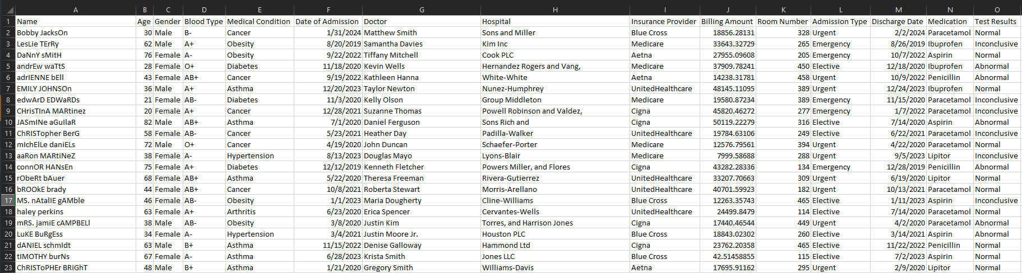
Research Questions
1. What is the impact of a patient's information to their billing amount
2. What are some relationships between different elements of the dataset
3. Based on our findings, who could best utilize the analysis we provided
Notes:
Matt will discuss the data cleansing.

Slide 3
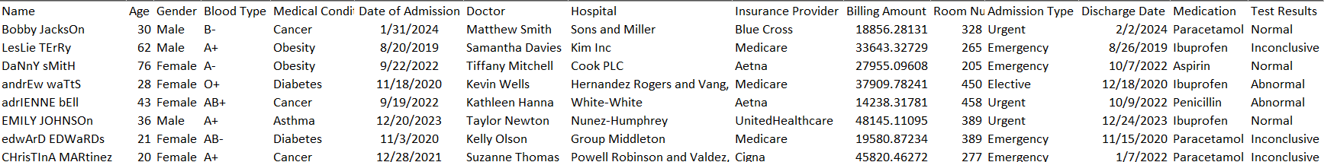
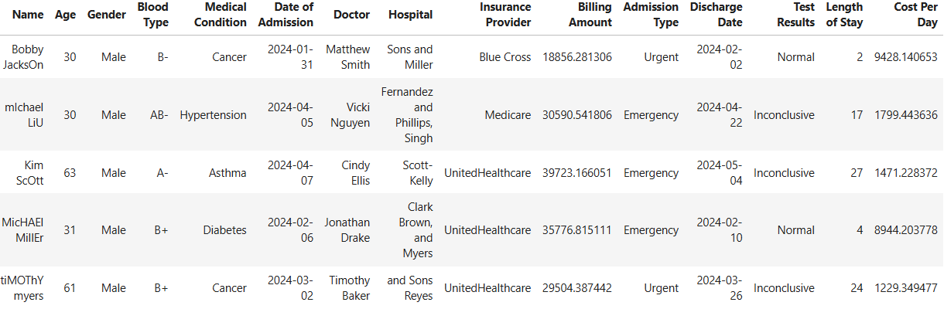
Initial CSV
Data Cleansed
SOPS: Data cleaning: The original dataset retrieved was a healthcare data set of hospital/clinic operations with the focus on treating Diabetes, Hypertension, Cancer, and Asthma. The first step of our analysis was cleansing the data. We first tested the code to ensure our selected year of 2024 revealed no errors and to ensure the data only reflected 2024 results. After cleansing the file, we began removing unnecessary columns that were not required for our analysis goal. Lastly, we performed a check for duplicates then began analyzing the remaining data.
Notes:
Matt will discuss the data cleansing.

Slide 4
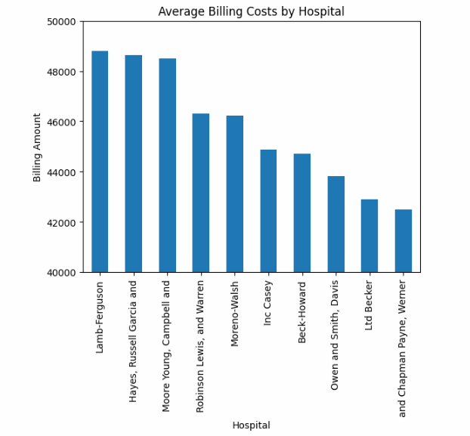
Average Billing Costs by Hospital:
Used to see which hospital can be seen as the most expensive from a patient’s perspective.
Lamb Ferguson is represented as the highest average billing cost per patient.
Notes:
Rosy will discuss.

Slide 5
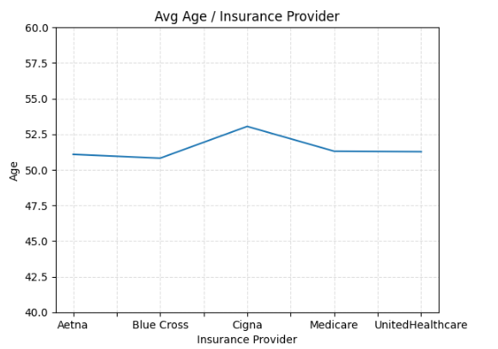
Age based on healthcare provider:
Indicates mean of age: Insurance provider
- Shows a trend of which insurance provider have better premiums for clients.
Notes:
Andre will discuss.

Slide 6
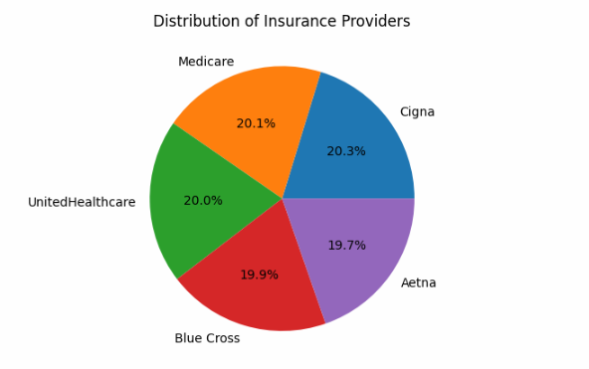
Distribution of Insurance Providers:
Very close but Cigna is the most common insurance provider at 20.3%
The least popular is Aetna at 19.7%
Notes:
Adontae will discuss

Slide 7
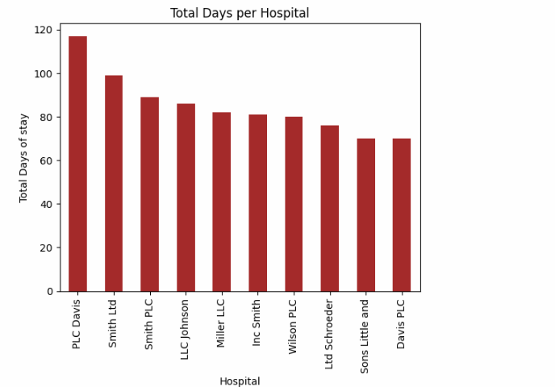
Total Days per Hospital:
- Length of Stay (LOS) equates to Discharge Date - Admission Date.
- Top 10 hospitals with combined LOS for all patients sampled for each facility.
- 40% of sample were between age 61 and 100.
- 52% related to elective stays which typically required more observation and recovery.
Notes:
Chris will discuss this one.

Slide 8
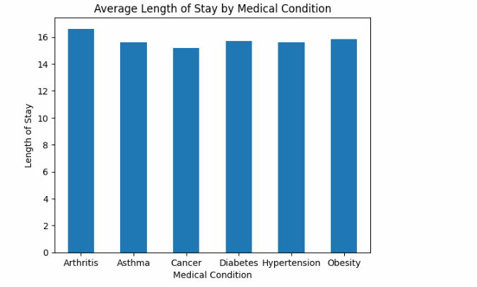
Average Length of Stay by Medical Condition:
Little variance of average length of stay between admission type (all were between 15-16 days).
Primary driven by Arthritis which can require up to a 2 week stay.
Asthma, varies from one day to more depending on various other factors.
Cancer, Diabetes, Hypertension and Obesity can vary as well depending on the type and severity.
X
Notes:
Chris to discuss

Slide 9
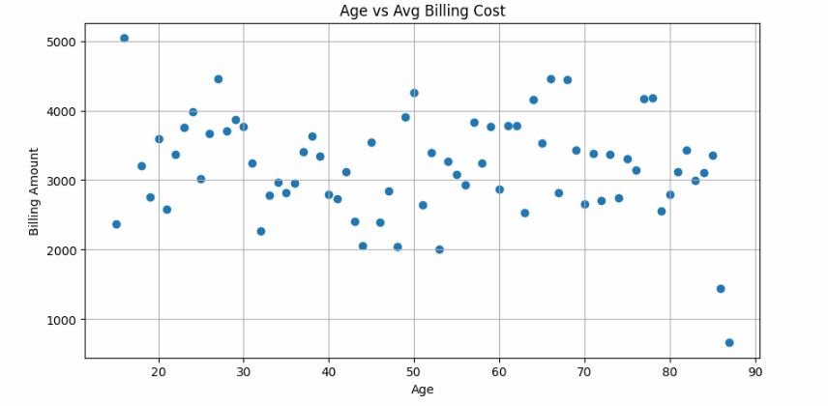
Age vs Avg Billing Cost:
Most results fall between a billing cost of $2,000 and $4,000 across all ages with some outliers
These outliers may reflect unique treatments, limited care, or specific insurance factors.
Additional analysis is needed to determine the impact of factors like treatment type, insurance coverage, or medical conditions on these costs.
Notes:
Rosy will discuss

Slide 10
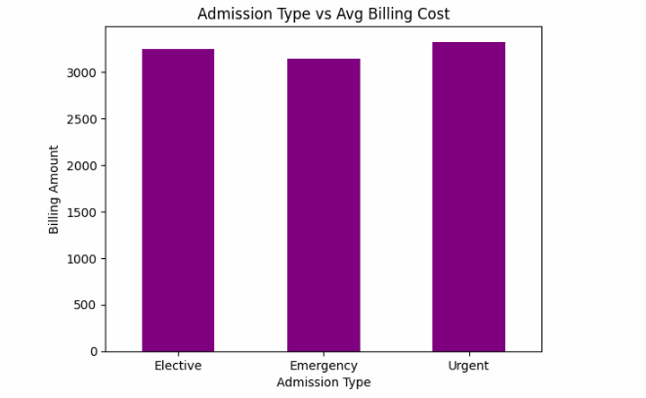
Admission Type vs Avg Billing Cost:
Elective, Emergency, and Urgent.
Very close but Urgent has the highest average billing cost.
Notes:
Andre will discuss

Slide 11
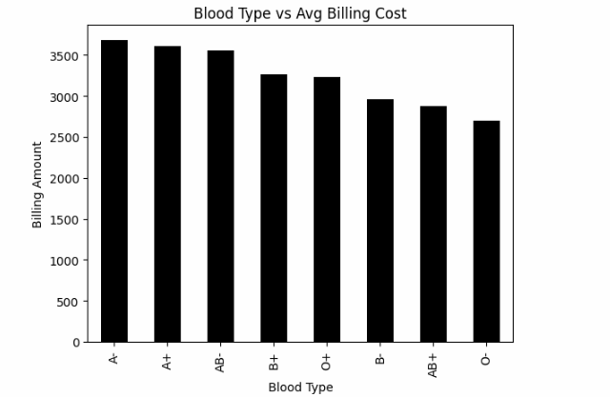
Blood Type vs Avg Billing Cost:
- A- blood type had the highest average billing cost
- O+ most common blood type
- AB negative, B negative some of the rarest blood types in the US
- Lack of correlation, it could be said rare blood types could result in a higher billing cost
Notes:
Alma will discuss

Slide 12
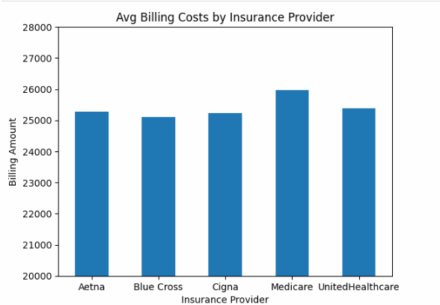
Avg Billing Costs by Insurance Provider:
Medicare is shown to have the highest average billing cost per patient
Little variance in cost between insurance providers.
Notes:
ADontae will discuss

Slide 13
Research Questions:
1. What is the impact of a patient's information to their billing amount.
No real correlation with the exception of those patients 60+ associated with arthritis.
Appears the hospitals are charging standard fees regardless age or gender.
2. What are some relationships between different elements of the dataset?
No real relationships could be identified as some of the information is inconclusive.
3. Based on our findings, who could best utilize the analysis we provided?
As it stands, the data appears to be incomplete as more analysis would be required to possibly include specific alignments and/or diagnosis and potentially the actual location of the facilities.
In our final analysis we’ve noticed that the data set is limited. However, it did not stop us from searching for our end goal. This data set can be used for patients, insurance providers, and hospitals. In this data set we were able to find which insurance provider’s may be the best fit for lower billing amounts for patients alongside which hospitals that can be a better fit for those in need of immediate accommodation and care. For hospitals and insurance providers it can give insight on which admission type along with which medical condition was more profitable for them. We calculated the majority of the correlations by finding the mean, and by doing so it can help them select their target demographic. Which condition and based on admission type they will profit off by.
Notes:
Donald to discuss

